Slide 1

Parkinson’s Disease Prediction.

Slide 2
Group Members
Nikhil Manikya, 700734200
Vamsi Sairam Adi, 700741207
Marneni Ashlesh, 700742493
Manideep Karne, 700725935

Slide 3
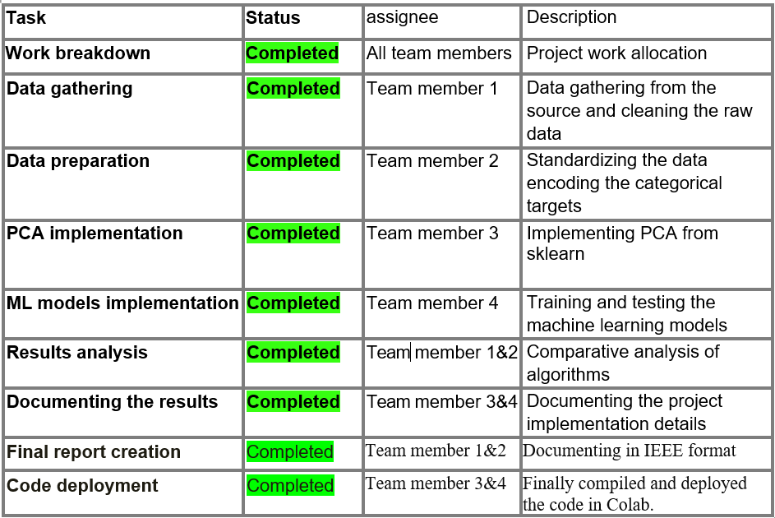
Roles and Contribution

Slide 4
Motivation
Research suggests that 90 percent of the PD patients experience speech impairment and voice disorders.
Some of the symptoms are breathiness in the voice, monotone of the voice, in appropriate articulation, soft voice that is low intensity and hoarse voice. Because of these symptoms, patients won’t participate in social interactions due to lack of confidence. With decreased communication affects the patient’s quality of life since communication is the key in everyone’s life. Once the patient or relatives notice the changes in voice of the Patient they can book the appointment with a speech therapist but the availability of the therapist in some locations is scarce and rare to find.
A virtual and automated speech impairment recogniser will be a great help to the PD patients. So, we are implementing automated machine learning models to detect the voice changes of the PD patient and normal people using some useful voice parameters.

Slide 5
Objectives:
Dataset has input features such as HNR, frequency, intensity, NHR. Few parameters are calculated in terms of frequency while few in ratios.
• The challenge of the project is to extract the best features from the data.
• Dimensionality reduction method like P.C.A is applied for feature extraction and to reduce the dimensions as possible.
• Later, Tree based algorithms help in classifying patients with P.D and people who are not suffering from P.D accordingly. Using labels like 1 or (0).

Slide 6
Features
P.C.A is used as a dimensionality reduction method in both supervised and unsupervised learning.
The features in voice are subjected to P.C.A for principal components that contain most of the information as before and the components are co-related with results.
Sometimes, it might not create a new axis with discriminant features.
To increase the variability and prevent data leakage tree-based algorithms are employed in our project.

Slide 7
Related Work:
Parkinson’s disease is a neuro degenerative disease which occurs due to reduced production of dopamine in the brain. One of the motor symptoms that appear in the PD patient are tremors and shivers.
One of the solutions to these tremors is using DBS(Deep Brain Stimulation) and the drawback is that though we apply these stimulation methods in the beginning they work fine and control the tremors in the patients but after some time the symptoms reappear.
So, In our paper we are proposing a method to find the stage of Parkinson’s disease and when the DBS(Deep Brain stimulation) needs to be started. This whole process is executed using mathematical tools and the Markov process using the medical parameters [5].

Slide 8
Problem Statement:
Parkinson’s disease is a neuro system disorder that affects functions like speech, writing and moments of muscles.
Major challenges for diagnosing the disease are: It is very difficult to find the symptoms in early stages and the symptoms of this disease overlap with the other neuro diseases.
This disease affects the person’s motor and non motor skills. If this disease is identified in the early stage the mortality rate of the patient can be increased significantly.
In the list of symptoms one of the main differentiable symptoms are speech impairment since the disease affects the functioning of jaw muscles this condition leads to changes in voice and pitch of the patient. Though this is an identifiable symptom, It is challenging task to identify with Voice Sample.
In our project we are mainly concerned with voice samples.

Slide 9
Project Solution
In this paper we are proposing a machine learning model to predict the class of Parkinson’s disease using smartphone voice samples data.
The data contains various components of the subject voice Frequency, Pitch and Intensity in various measures. Each voice record of the subject is broken into 512 components which is high dimensional data.
These records contain both healthy and patient Records. The project is divided into 2 steps one is dimensionality reduction method and the other one is classification.
The dimensionality reduction is achieved through PCA method and classification is implemented using machine learning ensemble models XGBoost and Gradient Boosting algorithms.
The performance of the models is evaluated based on several metrics including accuracy.

Slide 10
Methods:
PCA(Principal Component Analysis):
PCA is a dimensionality reduction method which reduces the dimensions of the data and preserves most of the information. In most of the cases reducing dimensions comes at the cost of losing the information.
The steps of PCA as follows:
1.Standardizing the data: We need to standardize the data since the data in further steps of PCA will become more vulnerable, which data with highest ranges will dominate the lower range data so we will normalize the data.
2.Covariance matrix: In this step we calculate the covariance matrix. This is to measure the variance of the data points from the mean with respect to each other. In this step if the variables are highly correlated those are considered as redundant variables and those can be ignored.
3.Computing Eigenvalues and Eigenvectors: From the covariance matrix we calculate eigen values and eigen vectors with the help of these we calculate the principal components. 4.Principal components: Principal components are the new vectors which are formed from the linear combination of the existing values with largest possible variance. 5.Forming a feature vector: In this step we form a feature vector with the help of eigen values and eigen vector. First, we sort the eigenvalues in the descending Order, and we decide whether we discard the less significant values or retain them in order to calculate the principal components.

Slide 11
Machine learning models:
XGBoost:
XGBoost algorithm is an Extreme Gradient Boosting algorithm which is an ensemble model that uses the predictions of the weak learners and combines those predictions to produce quality predictions.
XGBoost is used in real world applications as it handles large amounts of data very well.
Gradient Boost:
Gradient boosting is also an ensemble model which has the sequential models for prediction. In this case the predictions of the later model is improved compared to the previous model. The advantages of this algorithm are speedy predictions with high accuracy.

Slide 12
Results:
The performance of the models is evaluated using following parameters:
● Accuracy
● Precision
● Recall
● F1 score
● AUC-ROC curve
● Confusion matrix

Slide 13
References:
[1].S. Shinde, S. Satav, U. Shirole and S. Oak, "Comprehensive Analysis of Parkinson Disease Prediction using Vocal Parameters," 2022 International Conference on Machine Learning, Big Data, Cloud and Parallel Computing (COM-IT-CON), Faridabad, India, 2022, pp. 369-373, doi: 10.1109/COM-IT-CON54601.2022.9850857.
[2].M. Mamun, M. I. Mahmud, M. I. Hossain, A. M. Islam, M. S. Ahammed and M. M. Uddin, "Vocal Feature Guided Detection of Parkinson’s Disease Using Machine Learning Algorithms," 2022 IEEE 13th Annual Ubiquitous Computing, Electronics & Mobile Communication Conference (UEMCON), New York, NY, NY, USA, 2022, pp. 0566-0572, doi: 10.1109/UEMCON54665.2022.9965732.
[3].M. Giuliano, A. García-López, S. Pérez, F. D. Pérez, O. Sopite and J. Bossero, "Selection of voice parameters for Parkinson's disease prediction from collected mobile data," 2019 XXII Symposium on Image, Signal Processing and Artificial Vision (STSIVA), Bucaramanga, Colombia, 2019, pp. 1-3, doi: 10.1109/STSIVA.2019.8730219.

Slide 14
Thank You

